Slide 1
Smart Table Football
Bachelor/Engineering thesis
Link: smart-table-football.netlify.app
Jakub Jóźwiak

Slide 2
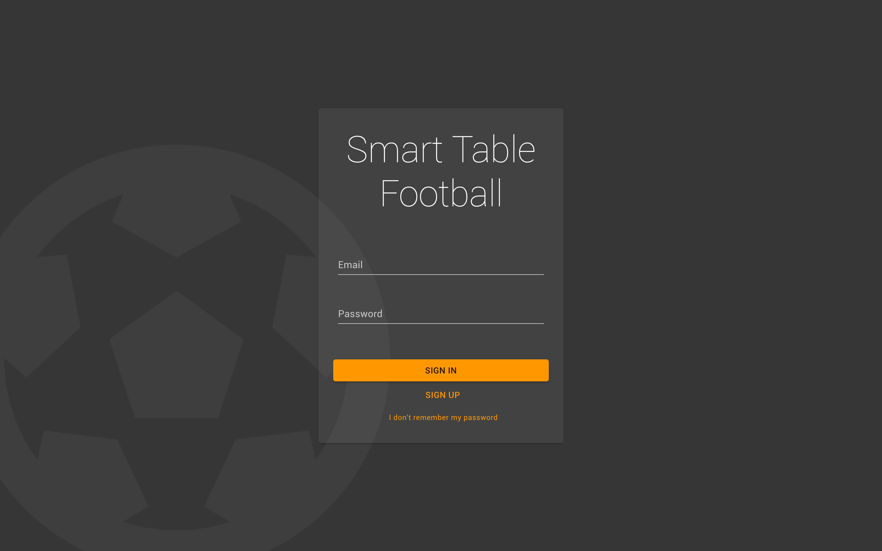
Full Web Service
Mail services
Password remainder
Emails notifications
Account manager

Slide 3
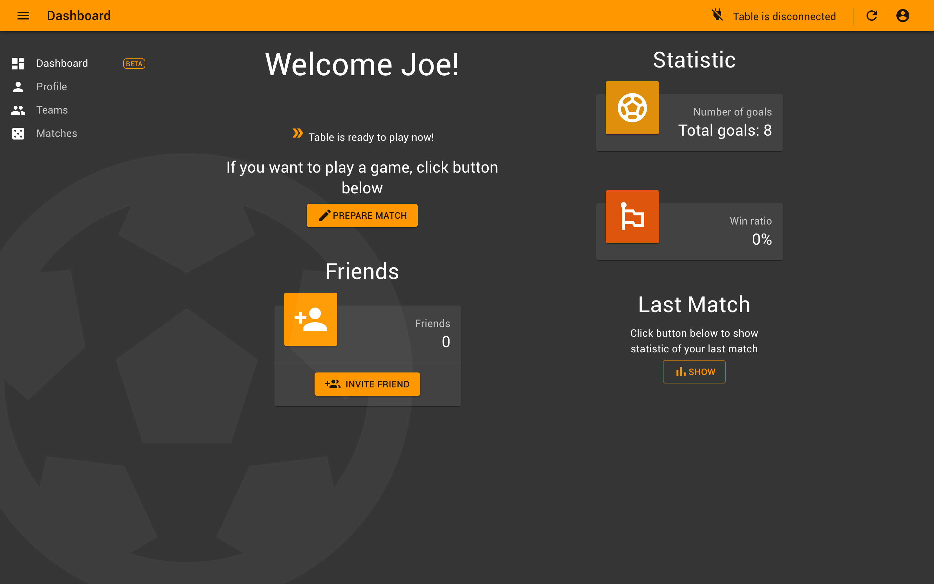
Dashboard
- Statistic
Most revelant information

Slide 4
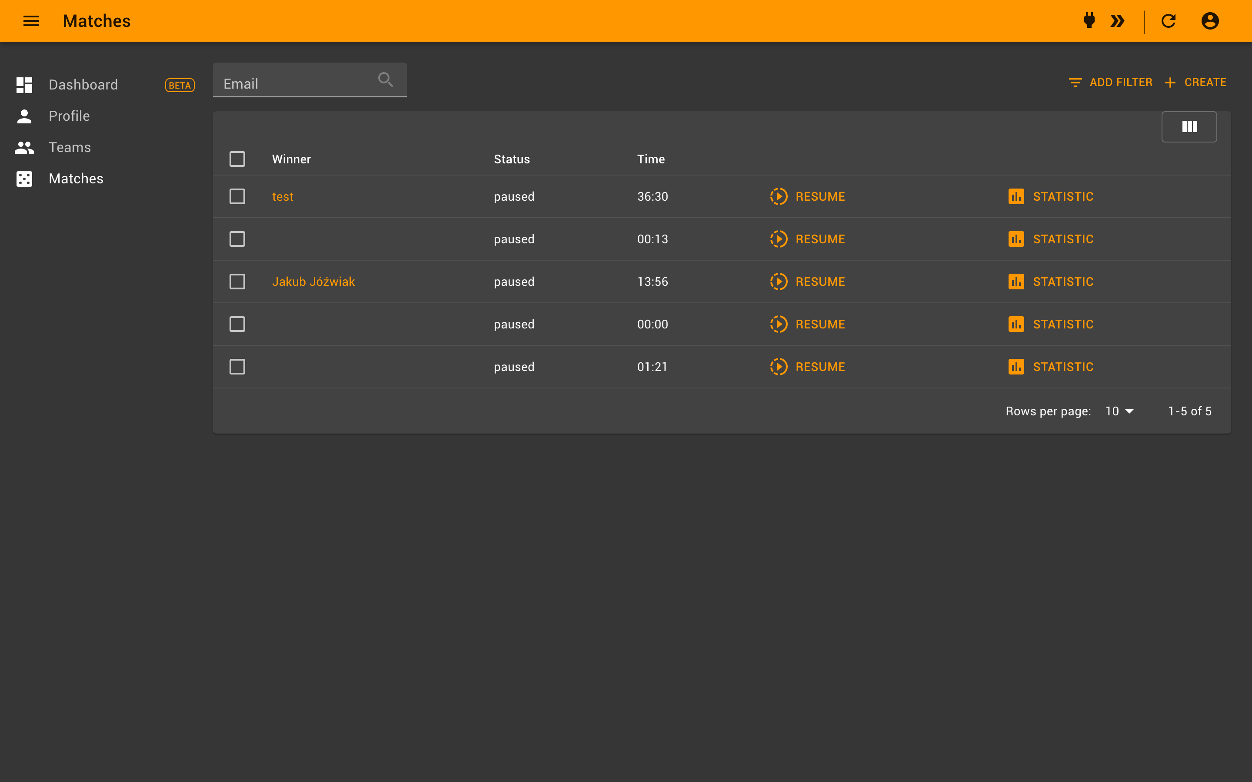
List View
- Invitations to match
- Ability to join into current match
- Creating Tournaments

Slide 5
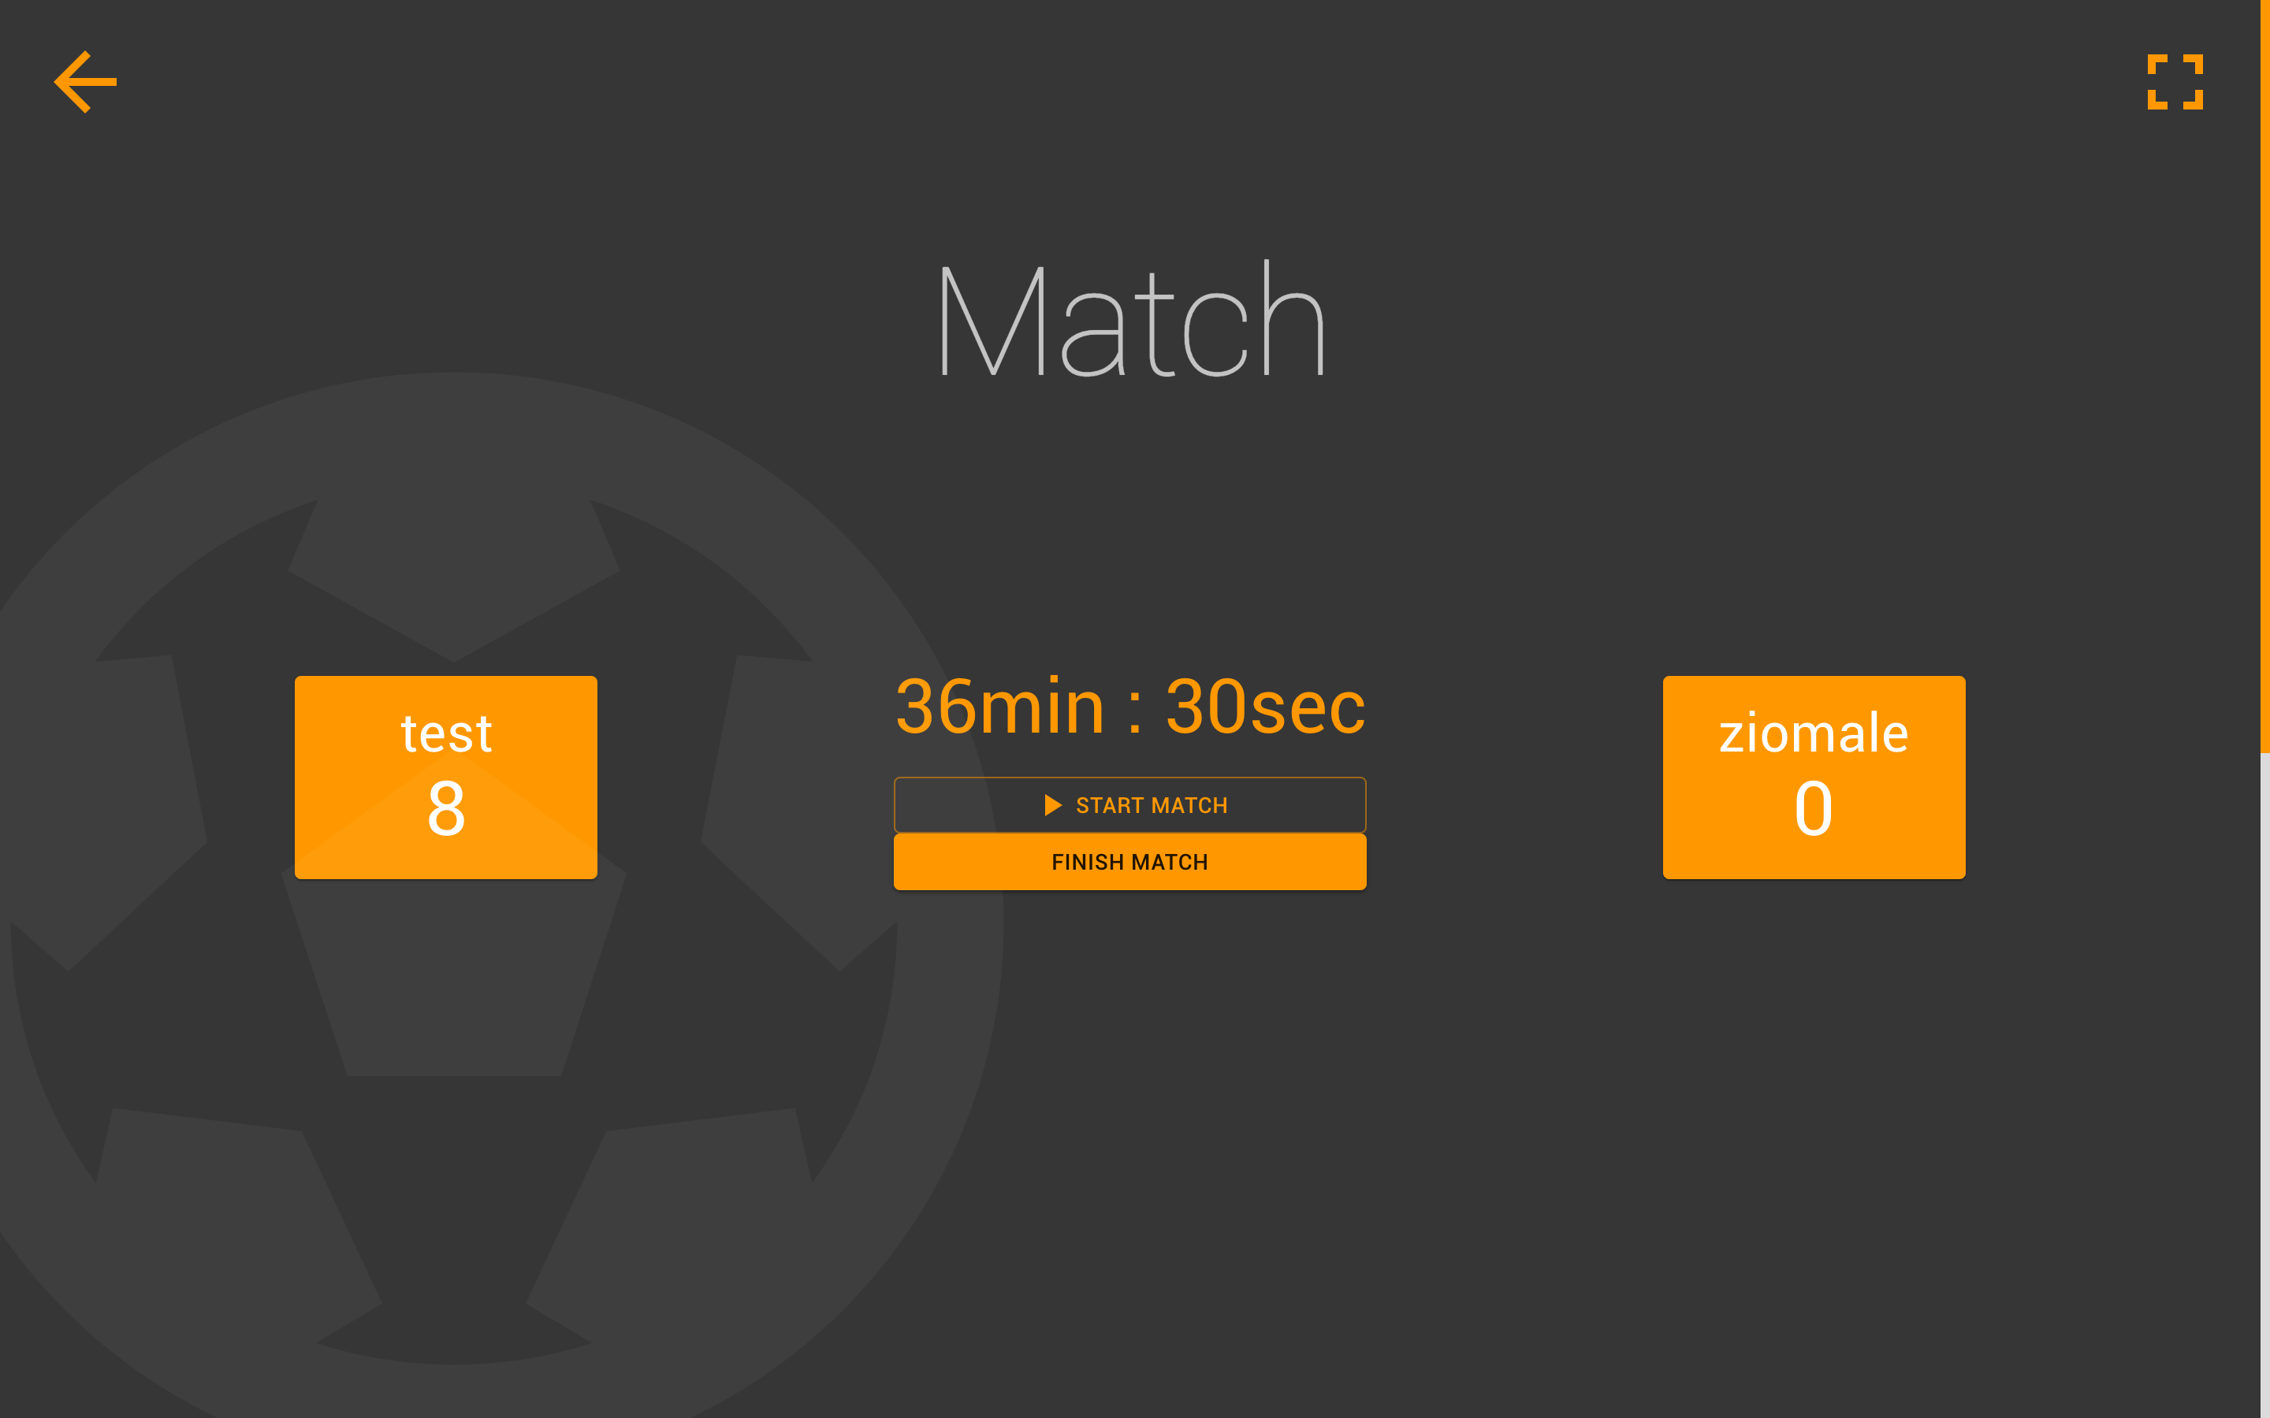
Game!
Screen game with real-time:
- Score
- Timmer
- Goals list with replay video

Slide 6
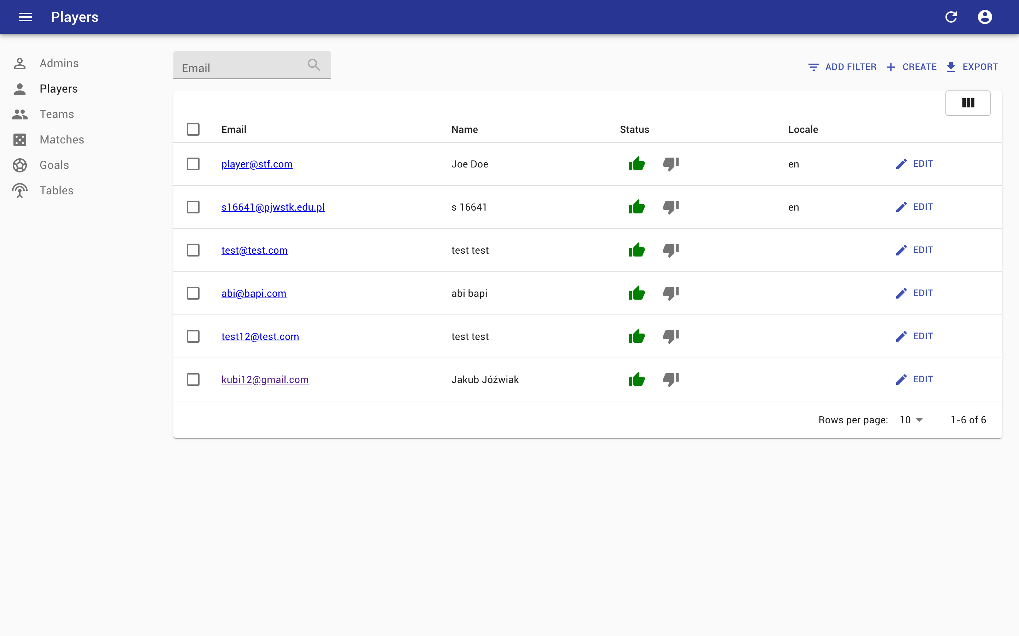
Administration Panel
Panel for admins of the system with the real time ability to perfom action and track statistics

Slide 7
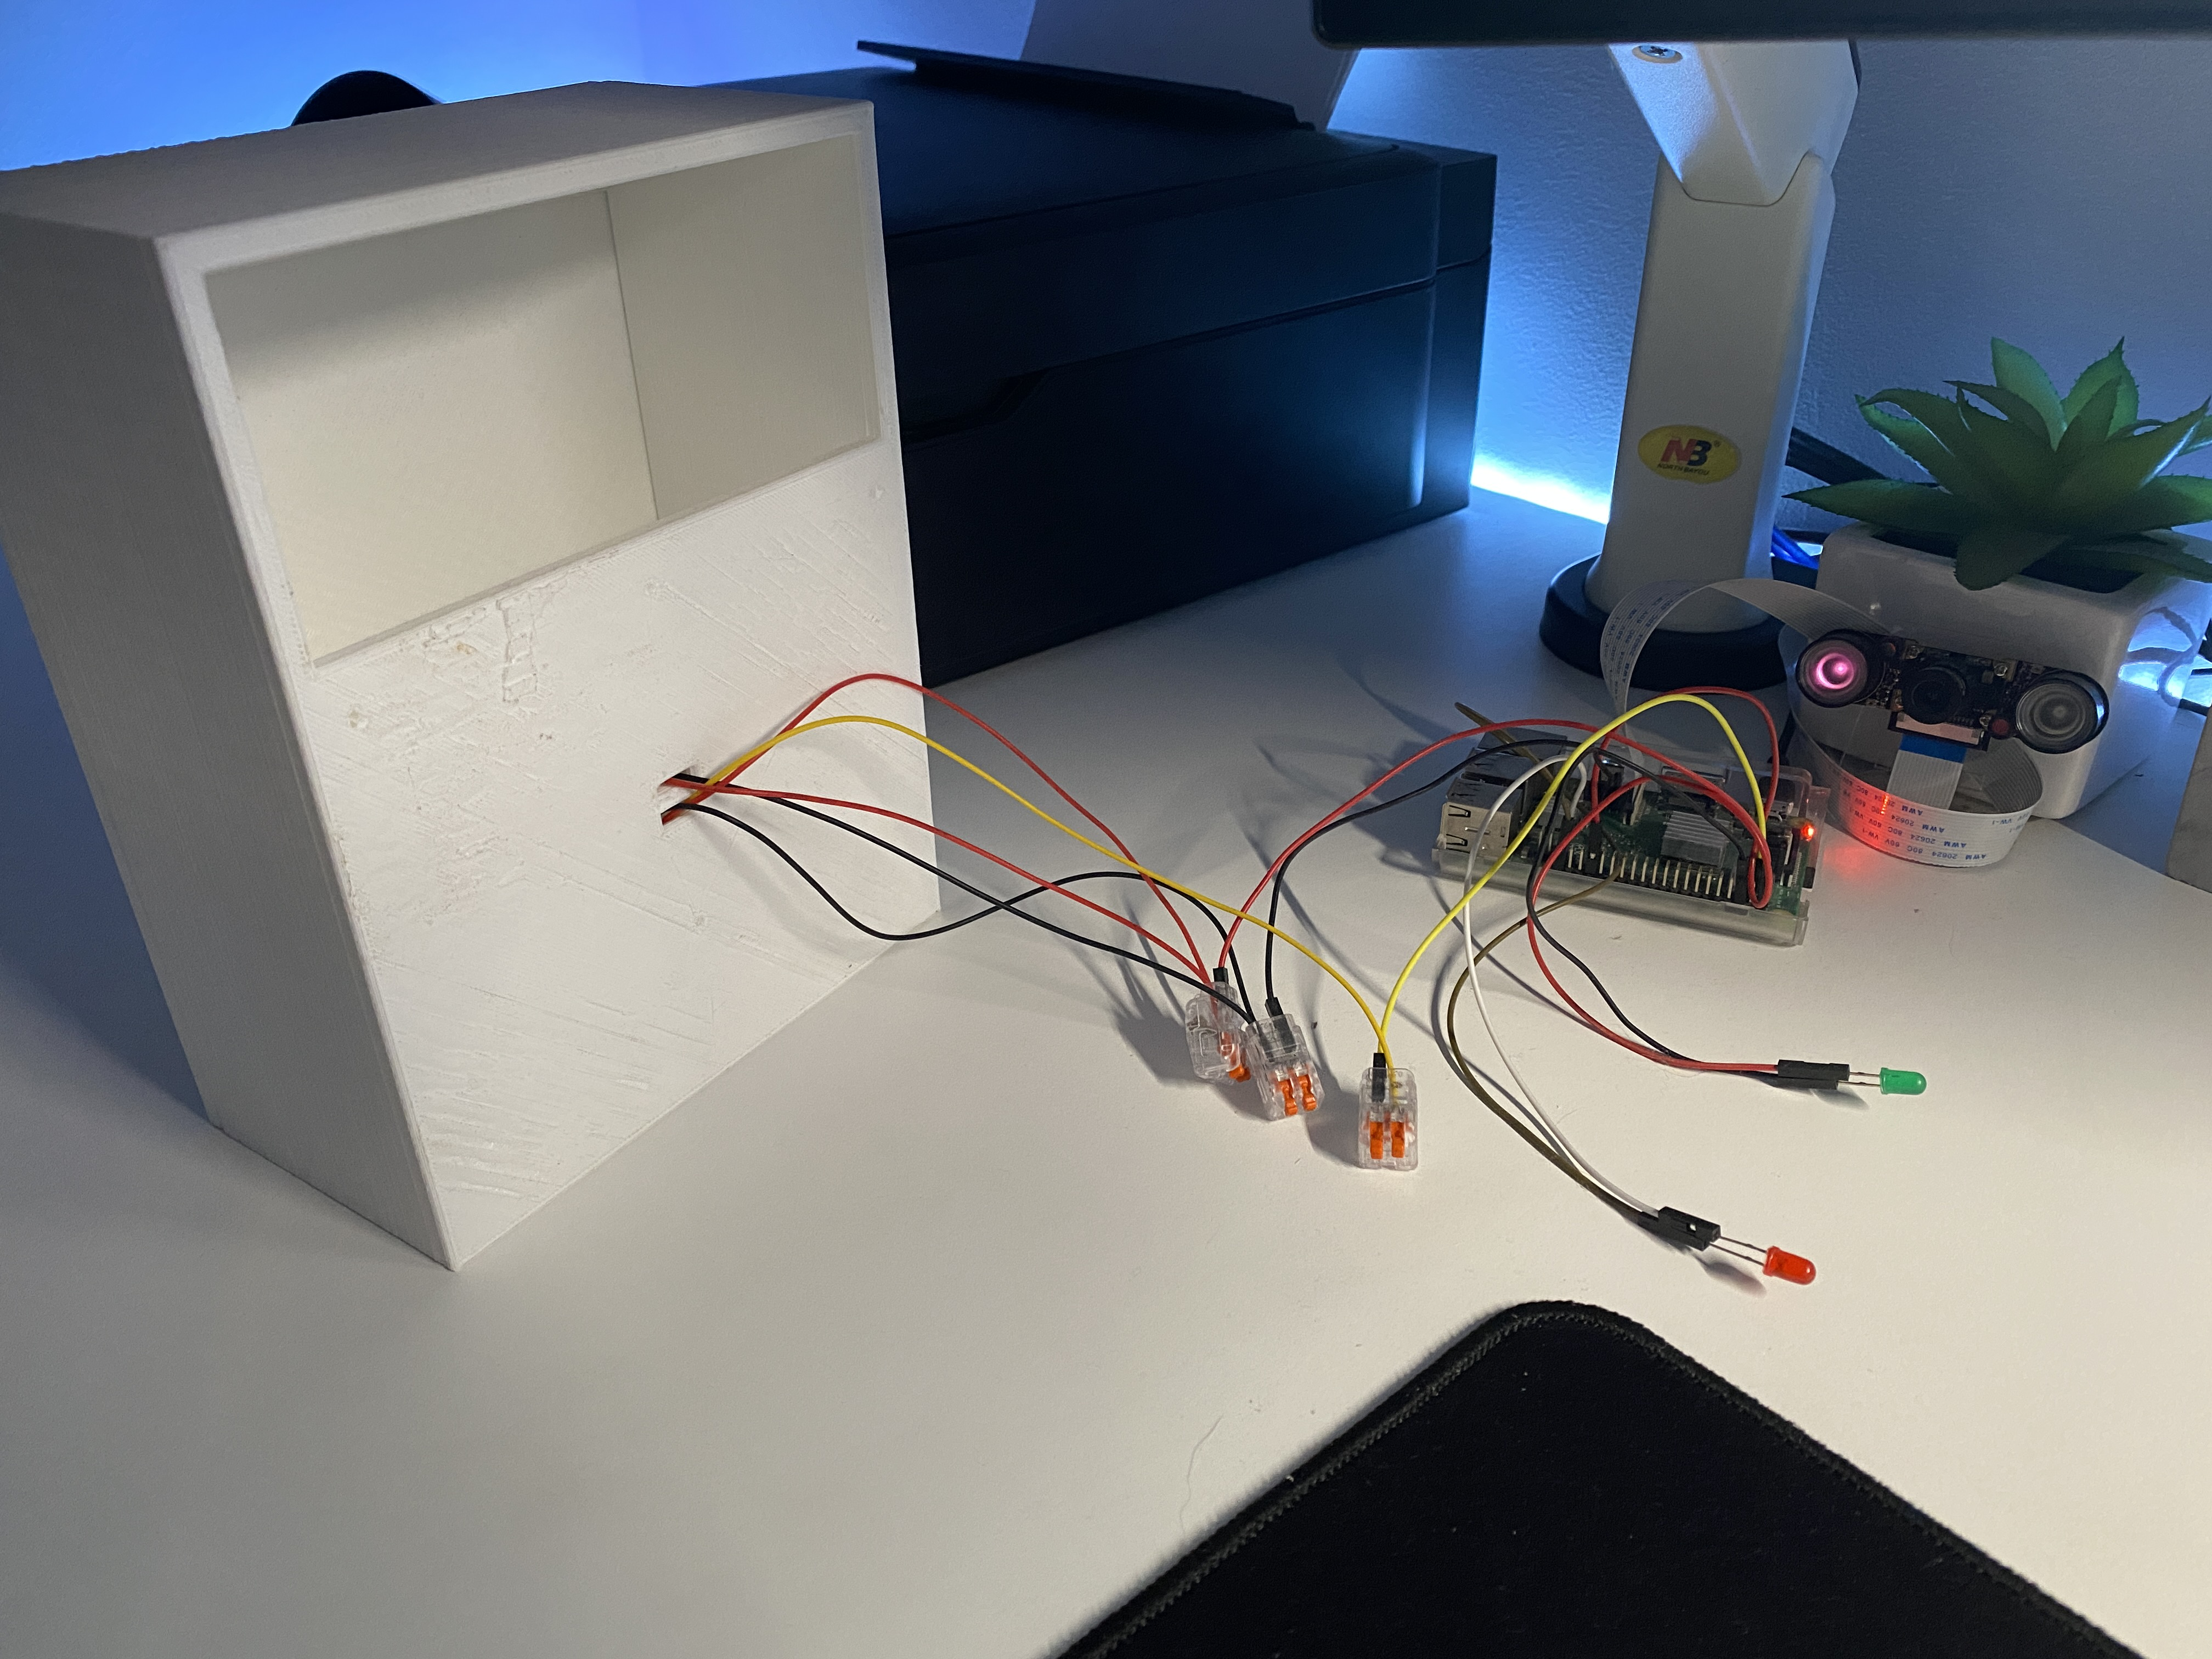
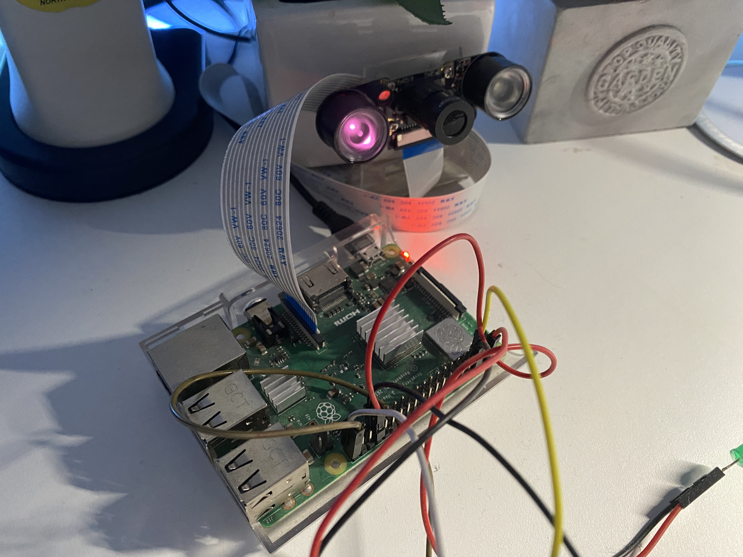
Raspberry Pi as a main hardware

Slide 8
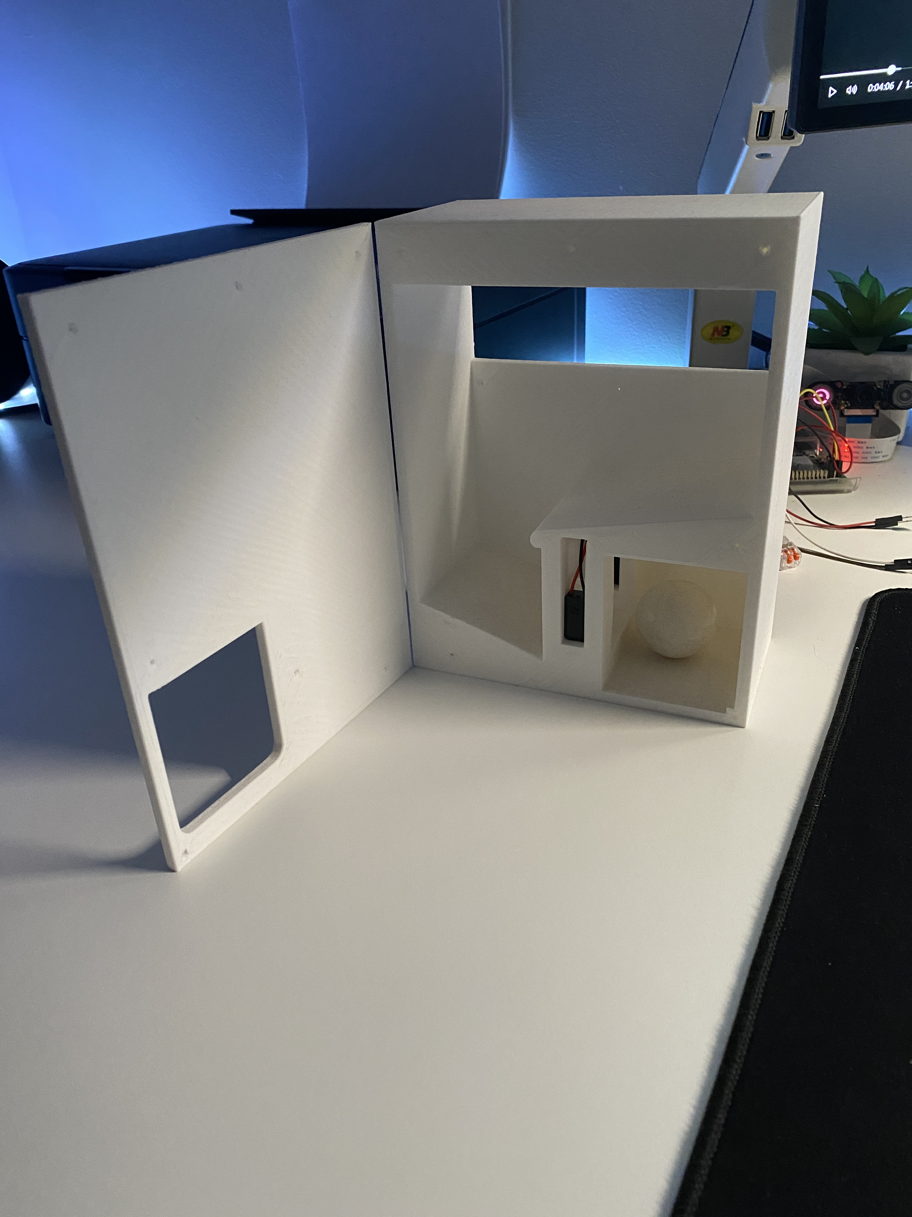
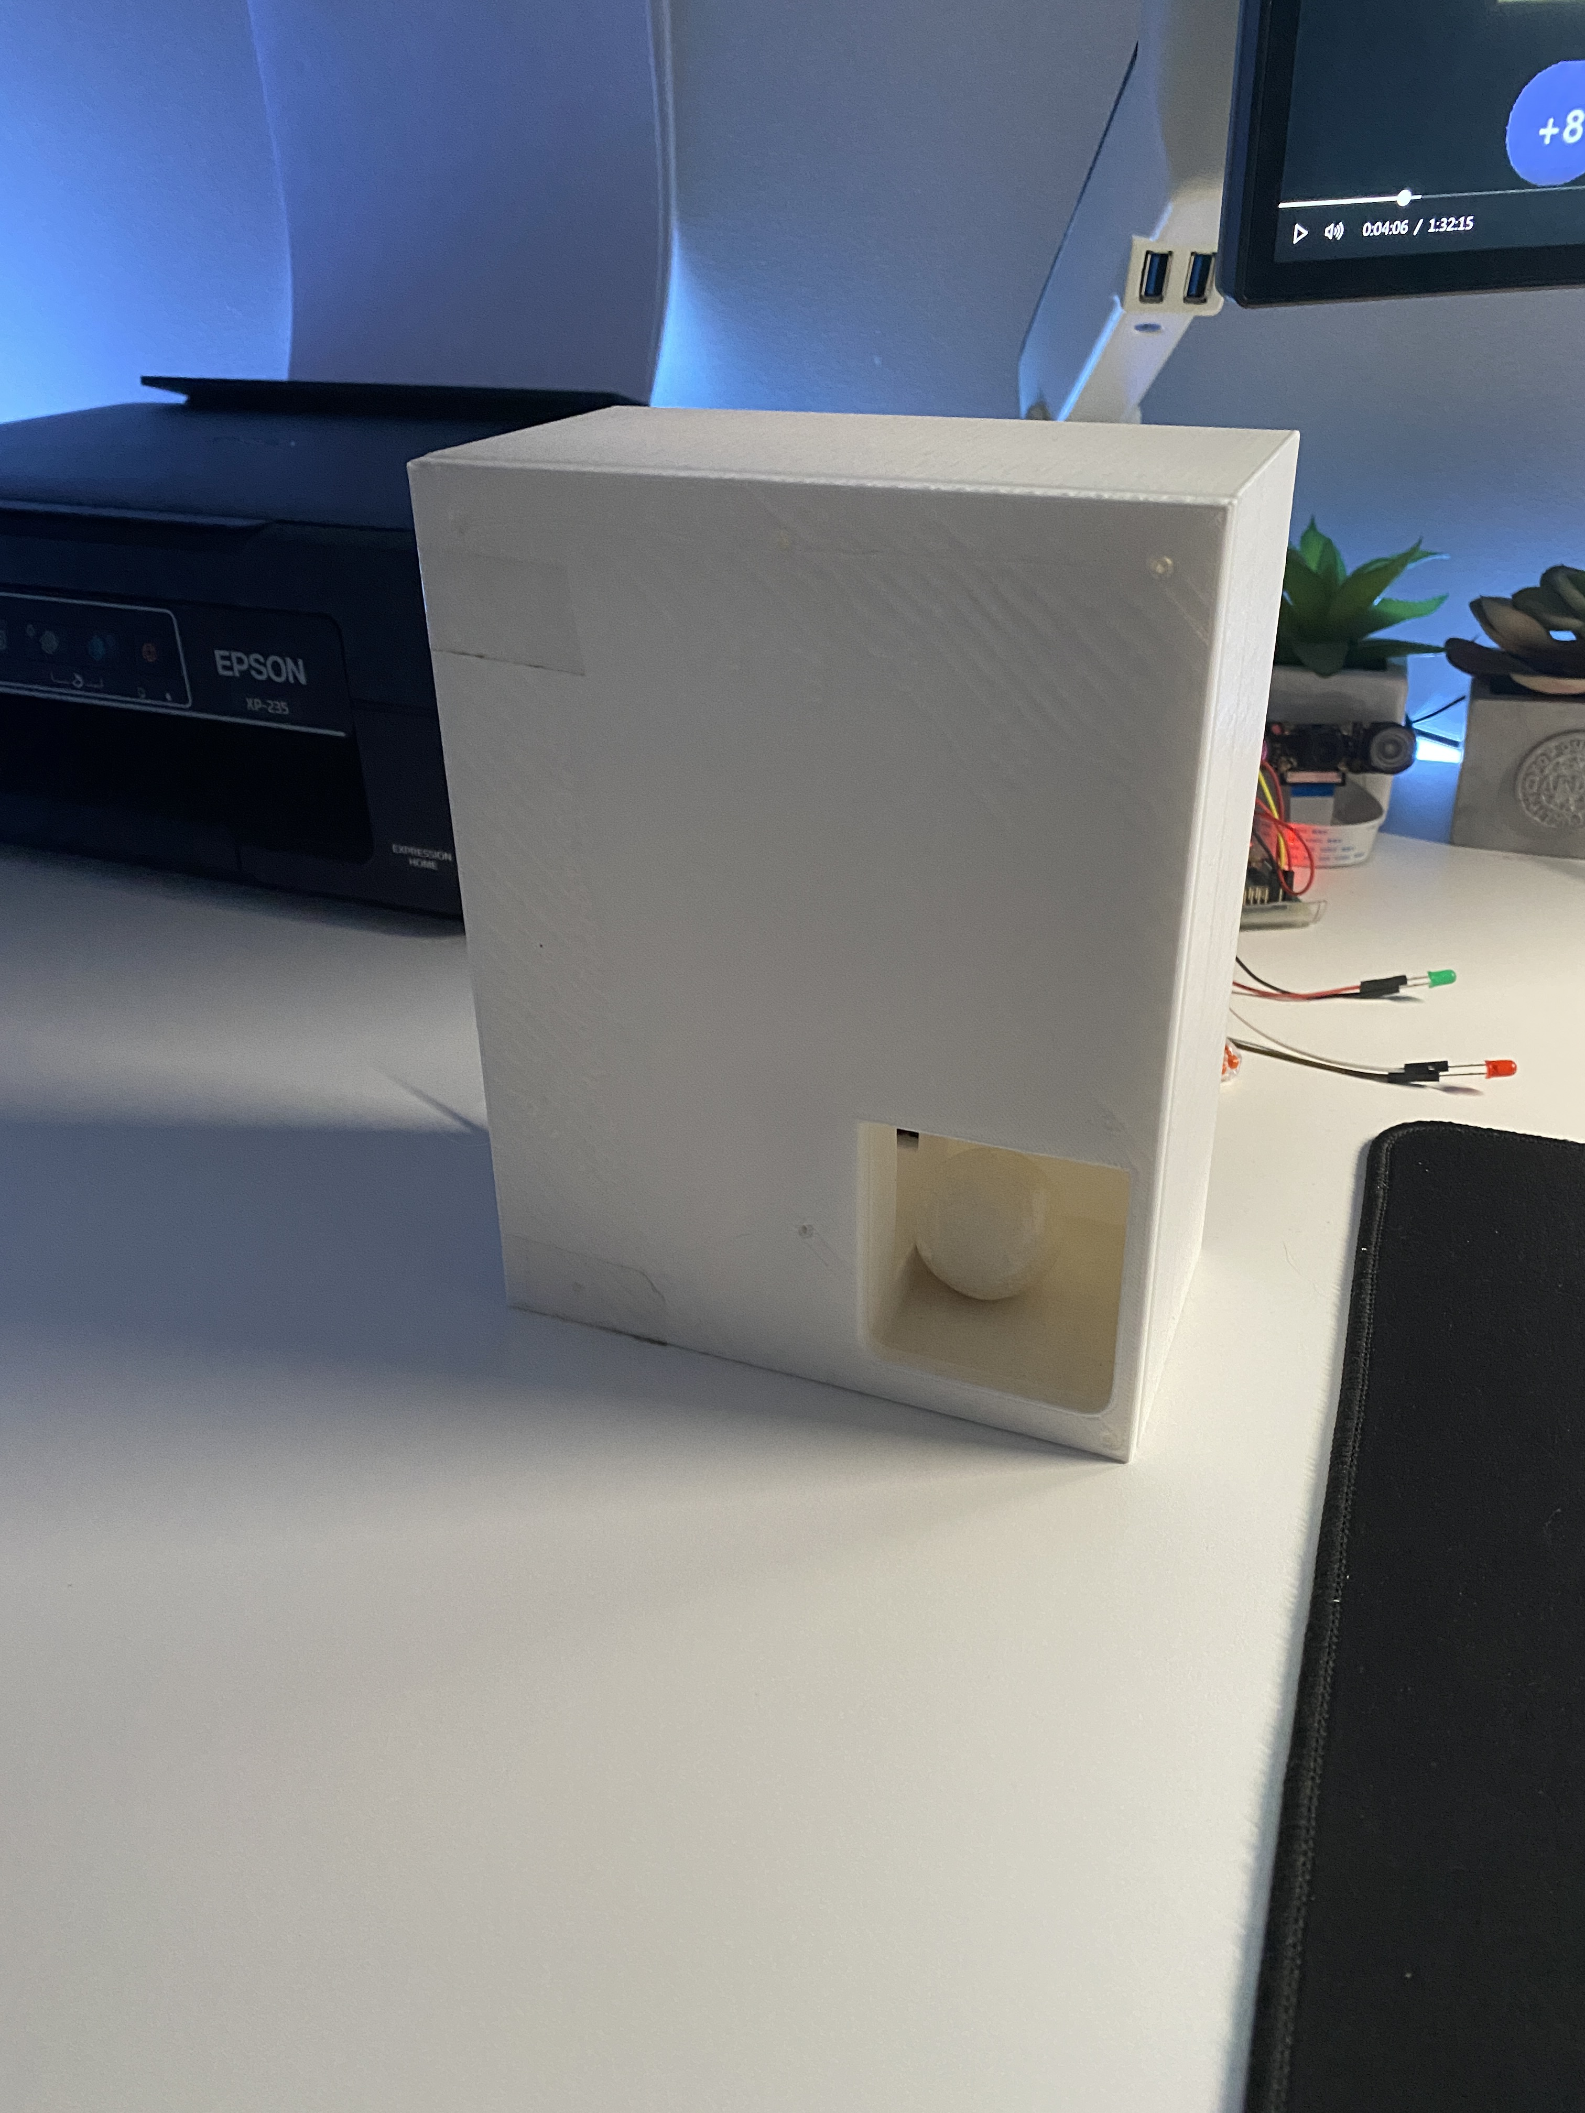
3D printed parts
- Design from basic patterns
- With printing precision to 0.2 mm

Slide 9
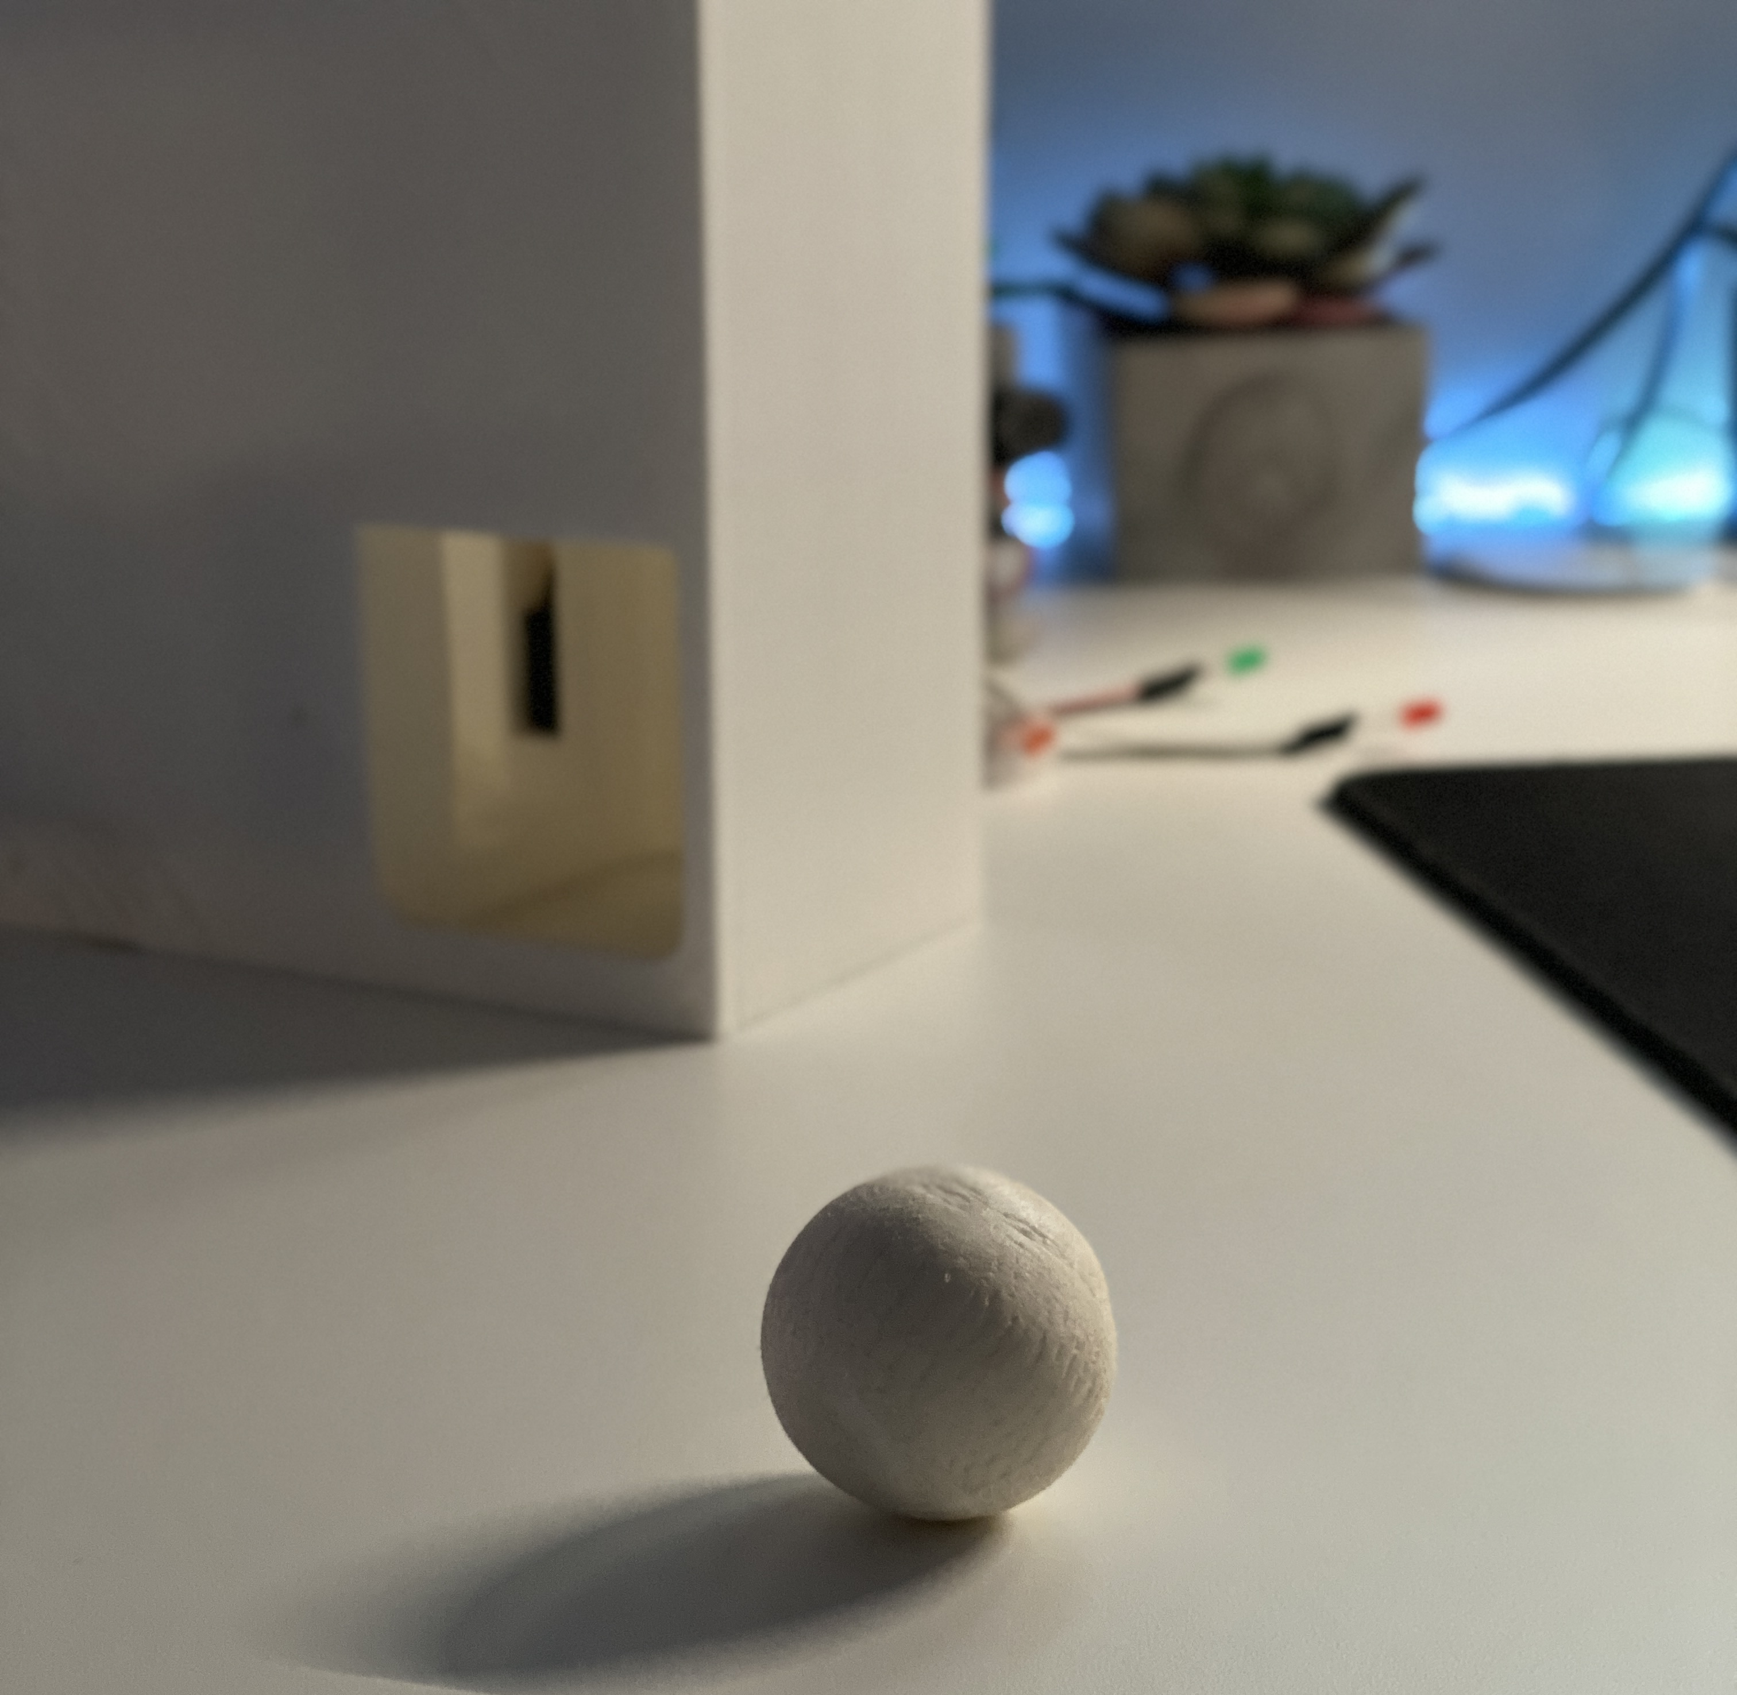
A ball with precise dimensions and weight

Slide 10
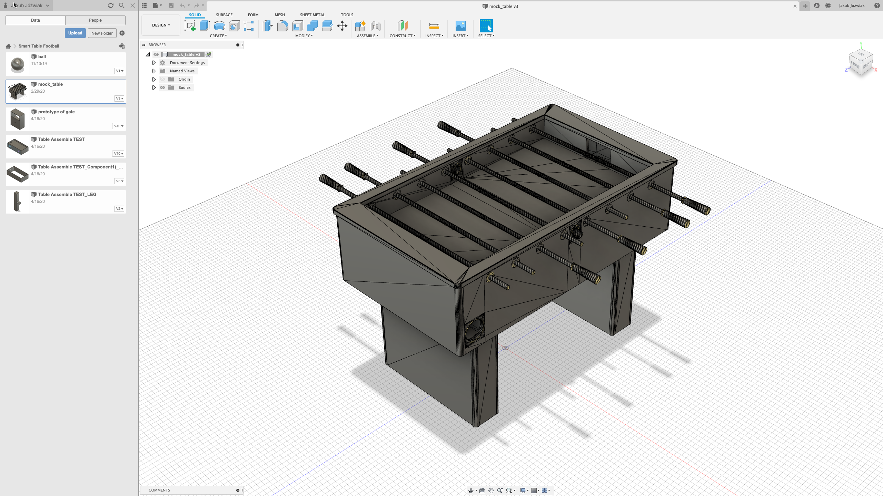
Full Table

Slide 11
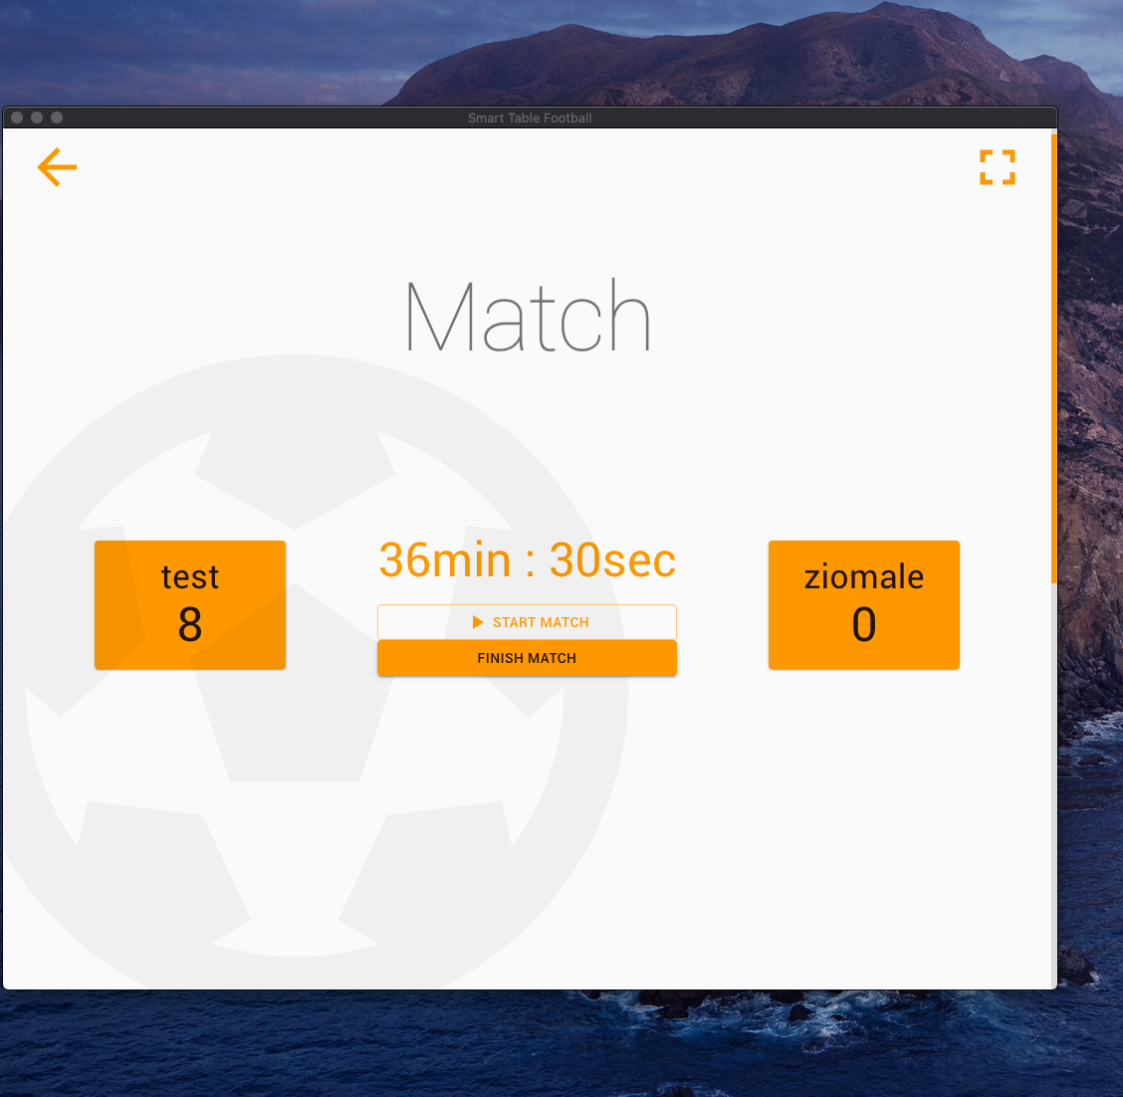
Native Application

Slide 12

Test coverage
Integration tests
E2E test
Unit Tests
Circle CI
BrowserStack (manual)

Slide 13
Integrations
Stripe - payments
Google Drive – data storage
Slack – communicator
Facebook/Google - social
YouTube – streaming

Slide 14
Summary
Create as prototype
Scalability into bussines
Great for testing and learning
Does anyone never thought about their own soccer table?

